Slide 1
Skeletonized Wave-equation Inversion for Q
Gaurav Dutta and Gerard T. Schuster*
Department of Earth Science & Engineering
King Abdullah University of Science and Technology
October 18, 2016

Slide 2
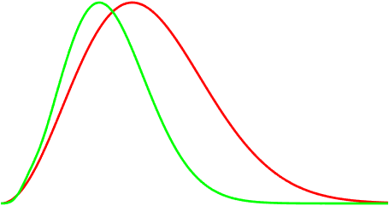
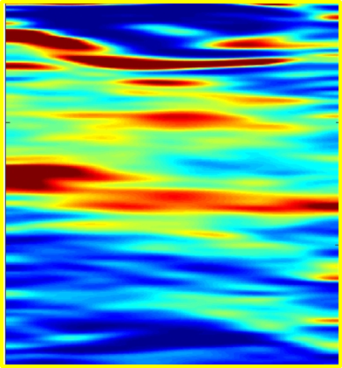
Outline
Predicted
Motivation
Theory of WQ
Numerical Examples
Synthetic Data Examples
Field Data Example
Limitations
Conclusions
Observed
$$f_{obs}$$
$$f_{calc}$$

Slide 3
Outline
Motivation
Theory of WQ
Numerical Examples
Synthetic Data Examples
Field Data Example
Limitations
Conclusions

Slide 4
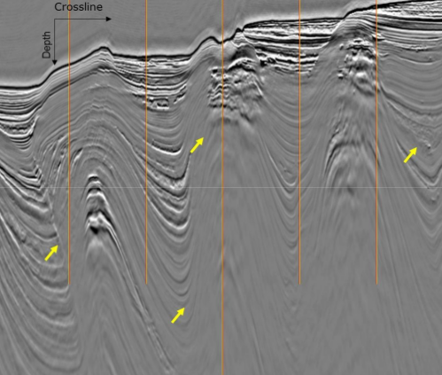
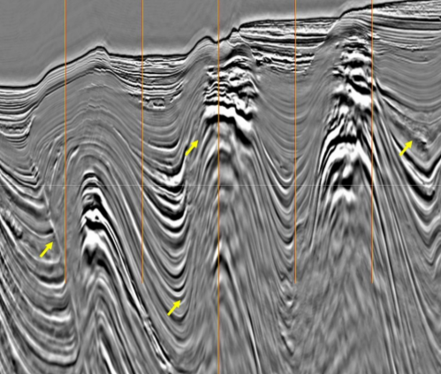
Motivation for Q Compensation
Offshore Brunei (Gamar et al., 2015)

Slide 5
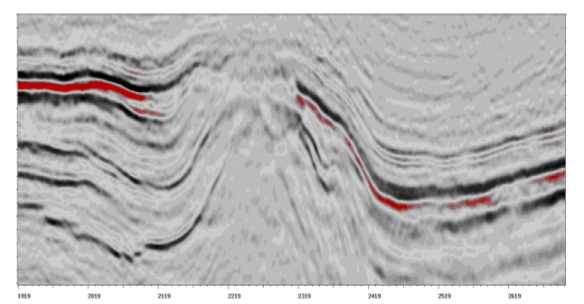
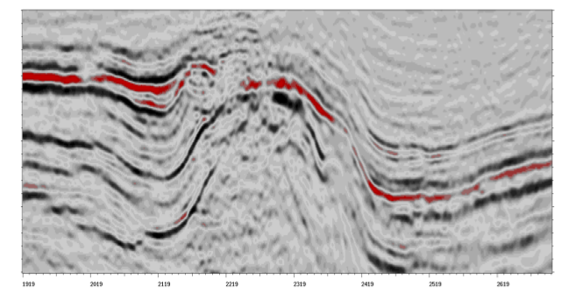
Motivation for Q compensation
North Sea (Valenciano and Chemingui, 2012)

Slide 6
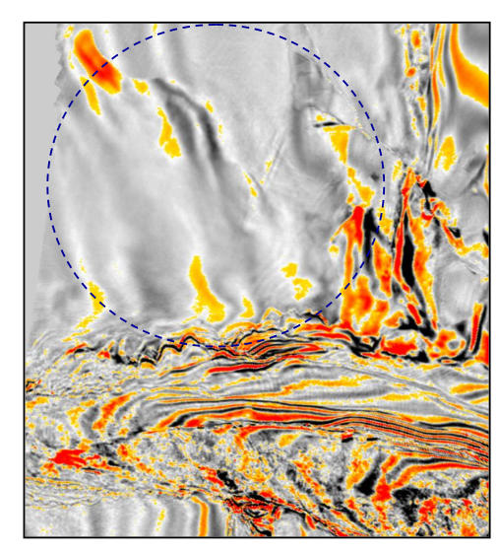
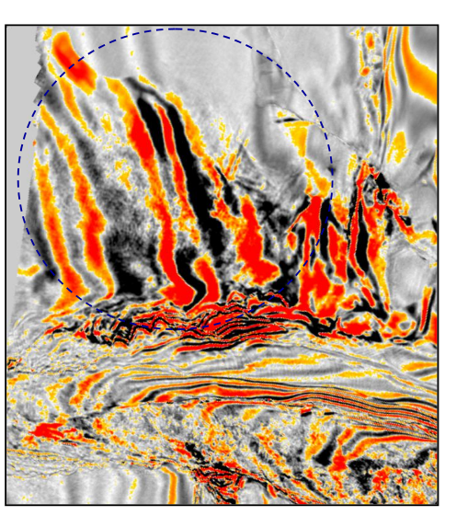
Motivation for Q Compensation
Offshore Brazil (Zhou et al., 2011)

Slide 7
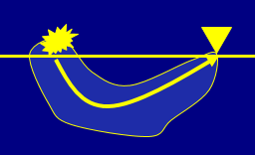
Motivation for Q Compensation
Problem: FWI Q(x,y,z) not robust
Solution: Skeletonized Inversion for Q
Predicted
Observed
$Δ$f
Predicted
ε=
Amp. Spectrum
2
$$ε=\frac{1}{2}\sum_{s}{\sum_{r}{Δf}}$$
Time
Observed
Frequency (Hz)
Y. Quan & Jerry Harris, 1997, Seismic attenuation tomography using the frequency shift method

Slide 8
Outline
Motivation
Theory of WQ
Numerical Examples
Synthetic Data Examples
Field Data Example
Limitations
Conclusions

Slide 9
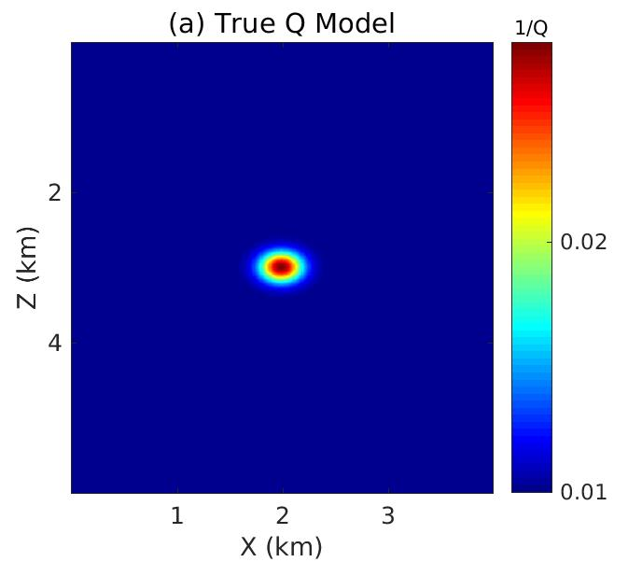
FWI vs Skeletal Inversion
FWI vs Skeletal Inversion
True Q Model
Q
200
Observed Traces
vs Predicted Traces
d(t)
2
time
ε=||d^{pred} - d^{obs} ||² vs Model
Z (km)
80
FWI gets stuck in local minima
ε
4
local minima
40
1
2
3
Model
X (km)

Slide 10
FWI vs Skeletal Inversion
FWI vs Skeletal Inversion
Observed vs Predicted Spectra
True Q Model
Q
Skeletal data = Peak Frequency
200
D(f)
2
f^{pred}
80
f^{obs}
Frequency (Hz)
Z (km)
ε=||f^{pred} - f^{obs} ||² vs Model
4
Skeletal inversion = rapid convergence
ε
global minima
40
1
2
3
X (km)
Model

Slide 11
Similarities with Wave-equation Traveltime Inversion
Properties
Wave-equation traveltime tomography (Luo and Schuster, 1991; Woodward 1992)
Wave-equation Q tomography (Dutta and Schuster, 2016)
Misfit function:
$$ε=\frac{1}{2}\sum_{s}{\sum_{r}{Δτ{\left(x_{r},x_{s}\right)}^{2}}}$$
$$ε=\frac{1}{2}\sum_{s}{\sum_{r}{Δf{\left(x_{r},x_{s}\right)}^{2}}}$$
Predicted
$$Δτ$$
Observed
$Δ$f
Gradient:
$$\frac{∂ε}{∂c(x)}=−\sum_{s}{\sum_{r}{\frac{∂Δτ}{∂c\left(x\right)}}Δτ(x_{r},x_{s})}$$
$$\frac{∂ε}{∂Q(x)}=−\sum_{s}{\sum_{r}{\frac{∂Δf}{∂Q\left(x\right)}Δf(x_{r},x_{s})}}$$

Slide 12
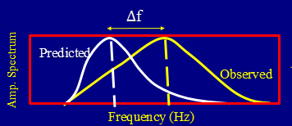
Wave-equation Q Tomography
There are 3 steps in WQ:
$$ε=\frac{1}{2}\sum_{s}{\sum_{r}{Δf{\left(x_{r},x_{s}\right)}^{2}}}$$
1) Misfit function $ε$:
$$\frac{∂ε}{∂Q(x)}=−\sum_{s}{\sum_{r}{\frac{∂Δf}{∂Q\left(x\right)}Δf(x_{r},x_{s})}}$$
$$Δf= f_{calc}(x_{r},x_{s})−f_{obs}(x_{r},x_{s})$$
$$Δf$$
We know dP/dQ from wave equation
2) Frechet Derivative : df/dQ =
3) Gradient: Q^{(k+1)} = Q^{(k)} - α$\frac{∂ε}{∂Q}$.
Smear frequency-shift residuals along wavepaths
Wave-equation Q tomography (Dutta and Schuster, 2016)

Slide 13
Viscoacoustic Wave Equation
SLS Model
Time-domain visco-acoustic wave equation:
$P=$ Pressure
$$\frac{∂P}{∂t}+K\left(τ+1\right)\left(∇⋅v\right)+r_{p}=f(x_{s},t)$$
$v=$ Particle velocity
$r_{p}=$ Memory variable
$$\frac{∂v}{∂t}+\frac{1}{ρ}∇P=0$$
$τ_{ε},τ_{σ}=$ Strain/Stress relaxation times
$τ_{σ}=\frac{\sqrt{1+\frac{1}{Q^{2}}}−\frac{1}{Q}}{ω}$
$$\frac{∂r_{p}}{∂t}+\frac{1}{τ_{σ}}\left(r_{p}+τK\left(∇⋅v\right)\right)=0$$
$τ_{ε}=\frac{\sqrt{1+\frac{1}{Q^{2}}}+\frac{1}{Q}}{ω}$
$$=\frac{2}{Q}\left(\frac{1}{Q}+\sqrt{1+\frac{1}{Q^{2}}}\right)$$
$$τ=\frac{τ_{ε}}{τ_{σ}}−1$$
$f=$ Point-source function

Slide 14
Outline
Motivation
Theory of WQ
Numerical Examples
Synthetic Data Examples
Field Data Example
Limitations
Conclusions

Slide 15
Synthetic Example
True Q Model
Q
Predicted
200
Observed
2
$$f_{obs}$$
$$f_{calc}$$
Z (km)
80
Acquisition
60 sources
200 receivers
$f_{peak}=$ 15 Hz
4
40
1
2
3
X (km)

Slide 16
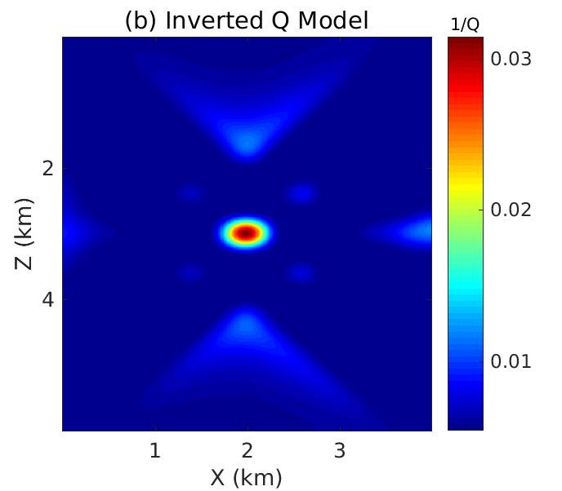
$$Δf$$
Predicted
Synthetic Example
Observed
True Q Model
$$f_{obs}$$
$$f_{cal}$$
Q
WQ Tomogram
Q
200
200
2
Z (km)
80
80
4
40
40
1
2
3
1
2
3
X (km)
X (km)

Slide 17
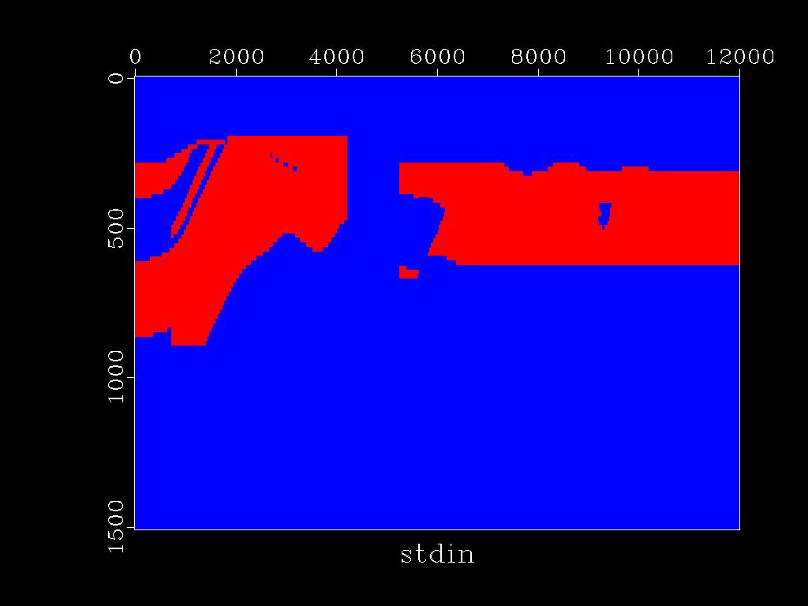
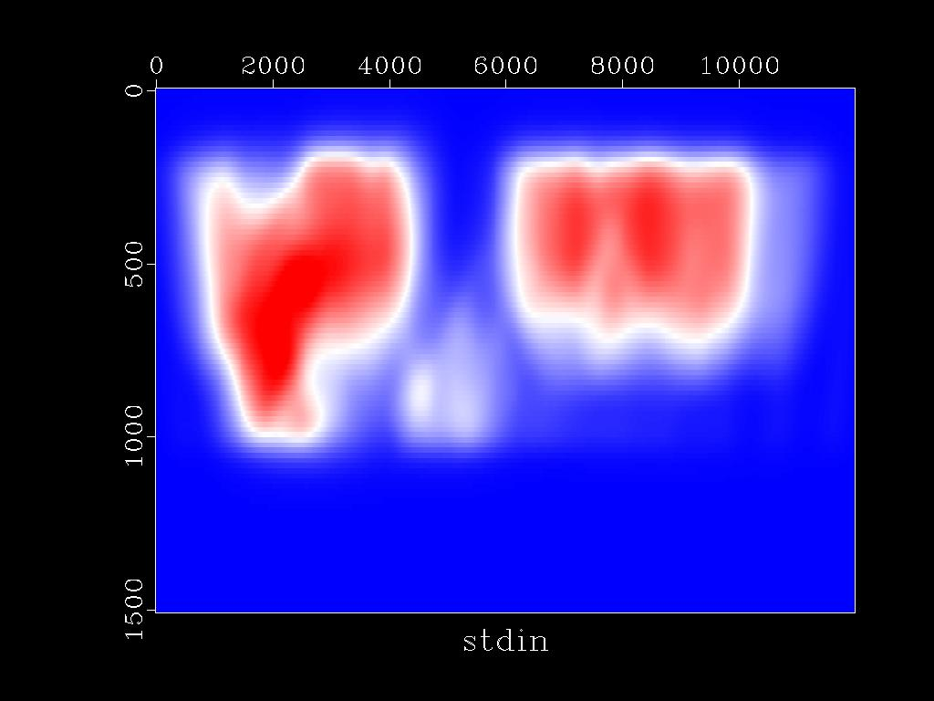
Observed
Synthetic Example
Predicted
True Q Model
Q
10000
0.5
Z (km)
1.5
WQ Tomogram
20
Q
10000
0.5
Z (km)
1.5
20
4
X (km)
8
12

Slide 18
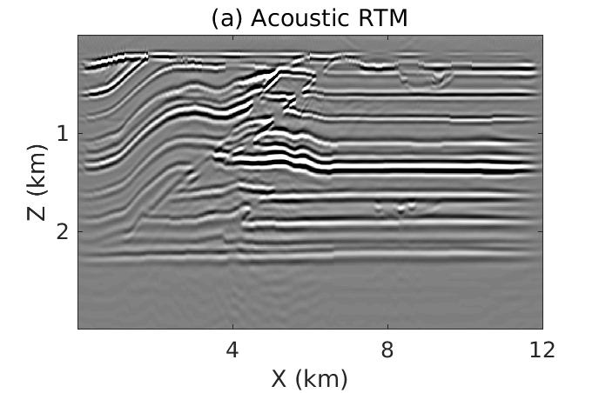
Standard RTM
1
Z (km)
2
4
8
12
X (km)

Slide 19
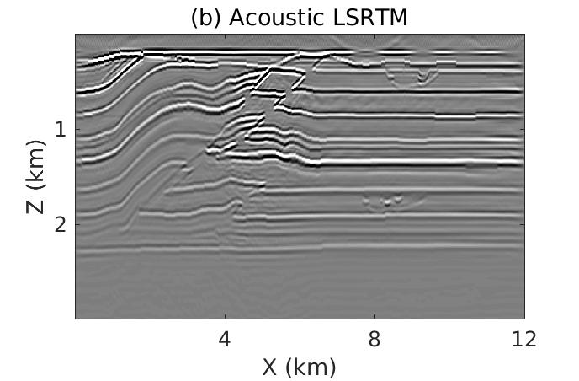
Standard LSRTM
1
Z (km)
2
4
8
12
X (km)

Slide 20
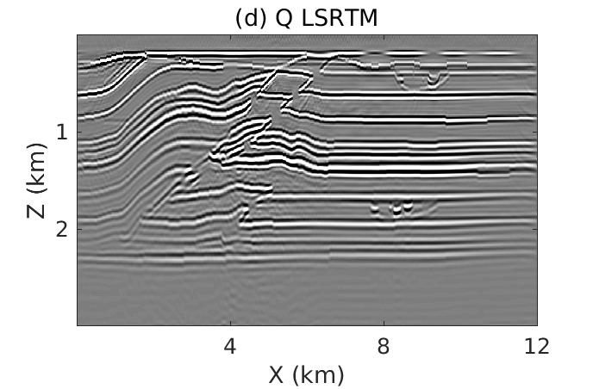
Q LSRTM
1
Z (km)
2
4
8
12
X (km)

Slide 21
Standard RTM
1
Z (km)
2
4
8
12
X (km)

Slide 22
Outline
Motivation
Theory of WQ
Numerical Examples
Synthetic Data Examples
Field Data Example
Limitations
Conclusions

Slide 23
Crosswell Field Data
183 m
9 m
9 m
3 m
3 m
305 m
293 m
Reflector
96 receivers
98 sources
Data Sampling: ¼ ms
Total Record Length: 0.375 s

Slide 24
Crosswell Field Data
Velocity Tomogram
km/s
Q Tomogram
Q
70
2.1
100
60
1.9
50
Z (m)
200
1.7
40
300
1.5
30
50
100
150
50
100
150
X (m)
X (m)

Slide 25
Predicted vs Observed Peak Frequencies
Hz
12
50
100
8
Source Index
150
4
200
100
200
300
400
Receiver Index

Slide 26
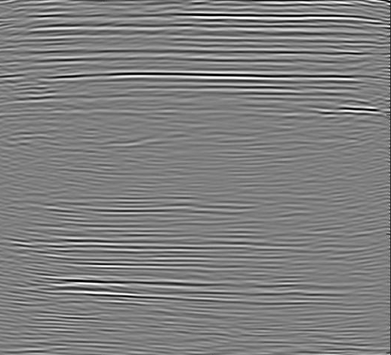
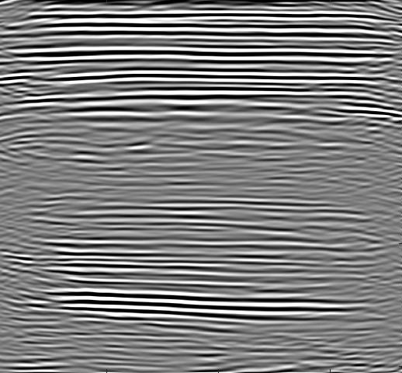
Crosswell Field Data
Standard Migration
Q-PSDM
100
Z (m)
200
300
50
100
150
50
100
150
X (m)
X (m)

Slide 27
Crosswell Field Data
Standard Migration
Q-PSDM
100
Z (m)
200
300
50
100
150
50
100
150
X (m)
X (m)

Slide 28
Outline
Motivation
Theory of WQ
Numerical Examples
Synthetic Data Examples
Field Data Example
Limitations
Conclusions
Motivation
Theory of WQ
Numerical Examples
Synthetic Data Examples
Field Data Example
Limitations
Conclusions

Slide 29
Limitations
Low-Intermediate Q resolution
Velocity-Q ambiguity: Q → time delays
Sequential Q and V inversion, or possibly simultaneous Q+V inversion

Slide 30
Outline
Motivation
Theory of WQ
Numerical Examples
Synthetic Data Examples
Field Data Example
Limitations
Conclusions

Slide 31
Conclusions
A novel wave-equation Q tomography method is presented.
Predicted
Observed
$$ε=\frac{1}{2}\sum_{s}{\sum_{r}{Δf{\left(x_{r},x_{s}\right)}^{2}}}$$
$$Δf= f_{calc}(x_{r},x_{s})−f_{obs}(x_{r},x_{s})$$
$$f_{obs}$$
$$f_{calc}$$
$$≈\sum_{s}{\sum_{r}{∫dt ∇⋅v(x,t;x_{s})\left(g\left(x_{r},−t;x,0\right)∗P{\left(x_{r},t;x_{s}\right)}_{obs}Δf(x_{r}, x_{s})\right)}}$$
Gradient:
Source
Backpropagated weighted residual
$$∫α dl=Δf$$

Slide 32
Conclusions
Inverted Q tomograms $⇒$ Improvements in imaging.
Standard Migration
1
Z (km)
2
4
8
12
X (km)

Slide 33
Conclusions
Inverted Q tomograms $⇒$ Improvements in imaging.
Q-PSDM
1
Z (km)
2
4
8
12
X (km)

Slide 34
Conclusions
Inverted Q tomograms $⇒$ Improvements in imaging.
Standard Migration
Q-PSDM
100
Z (m)
200
300
50
100
150
50
100
150
X (m)
X (m)

Slide 35
Limitations
Low-Intermediate Q resolution
Velocity-Q ambiguity
Sequential Q and V inversion, or possibly simultaneous Q+V inversion

Slide 36
Acknowledgements
SEG for providing this platform.
Sponsors of the CSIM consortium.
Exxon for the Friendswood data.
KAUST Supercomputing Laboratory and IT Research Computing Group.

Slide 37
Motivation for Q Compensation
Problem: Q distorts amplitude and phase of propagating waves.
Q=1000
Q=40
Q=20
2
Z (km)
4
4
X (km)
8
4
X (km)
8
4
X (km)
8
$f_{peak}=20$ Hz

Slide 38
Motivation for Q Compensation
Problem: Q distorts amplitude and phase of propagating waves.
Q=1000
Q=40
Q=20
2
Z (km)
4
4
X (km)
8
4
X (km)
8
4
X (km)
8
$f_{peak}=20$ Hz

Slide 39
Motivation for Q Compensation
Problem: Q distorts amplitude and phase of propagating waves.
Q=1000
Q=40
Q=20
2
Z (km)
4
4
X (km)
8
4
X (km)
8
4
X (km)
8
$f_{peak}=20$ Hz

